Slide 1
Alexander Forbes Annual Retirement Fund Survey 2019 – Key Insights

Slide 2
Annual Retirement Fund Survey
Now in its 25th year …
“… has analysed key statistics and findings each year since inception, providing the industry with access to performance and risk information”

Slide 3
Annual Retirement Fund Survey
14 Surveys
60 Managers
412 Funds
Enhancements post-1998
Risk profiling
SA-only and Global-only portfolios
Benchmark returns
Risk-adjusted measures
Property Survey
Surveys
Revamped
1994
Manager Watch Performance-Only Survey – a market first!
2013
Formalised Survey Governance
2001
Absolute
Return Survey
2003
Specialist
Bond Survey
2007
Medical
Aid Survey
2015
Survey Rules
2017
New Survey Technology
2019
Africa Survey Development
1998
Manager Watch™ Survey revamped
Participation criteria set
Large Manager Watch™
  Launched June 1998
  Top 10 active balanced managers
RDP Survey (later renamed Targeted Development Investments Survey
2002
Money Market
Survey
2004
Hedge
FoF Survey
2006
InternationalSurvey
2010
BEE Survey
2012
LDI Survey
2014
Equity Funds Analysis
Survey Rules Updated, New LMW Definition
2018
Shari’ah Survey

Slide 4
The Alexander Forbes Manager Watch™ Survey of Retirement Fund Investment Managers
Showcases the performance of institutional fund managers in South Africa
Reveals the country’s largest and best asset managers
Highlights their BBBEE ratings
Encourages accountability, competition and improved transparency through good governance
Ensures that data integrity is maintained
Allows the industry to retrospectively monitor the quality and consistency of the investment data received

Slide 5
Annual Retirement Fund Survey
14 Surveys
60 Managers
412 Funds
SA Manager Watch™ and Global Manager Watch™ Survey – Balanced Mandates
SA Equity Manager Watch™ Survey
SA Bond Manager Watch™ Survey
SA Money Market Manager Watch™ Survey
Absolute Return Manager Watch™ Survey
Targeted Development Investment Survey
Fund of Hedge Funds Survey
SA Property Manager Watch™ Survey
Multi-Manager Watch™ Survey
Medical Aid Manager Watch™ Survey
BEE Manager Watch™ Survey
LDI Manager Watch™ Survey
Shari'ah Manager Watch™ Survey
3 Balanced Surveys
10 Specialist Surveys
1 Multi-Manager Survey

Slide 6
The largest asset managers
2017 Rank 1 | 2018 Rank | Change | Asset Manager | Total AUM (R m)* | Total SA Assets (R m) | BEE status
1 | 1 | - | Old Mutual Investment Group | 645 | 493 | Level 2
2 | 2 | - | Coronation Fund Managers | 532 | 422 | Level 3
3 | 3 | - | Investec Asset Management | 527 | 318 | Level 2
4 | 4 | - | Allan Gray Limited | 522 | 342 | Level 4
5 | 5 | - | STANLIB Asset Management | 483 | 480 | Level 2
6 | 6 | - | Sanlam Investment Management | 478 | 380 | Level 3
7 | 7 | - | Alexander Forbes Investments | 312 | 244 | Level 3
- | 8 | N/A | Nedgroup Investments | 250 | 197 | Level 2
9 | 9 | - | Sanlam Multi-Manager International | 209 | 166 | Level 3
8 | 10 | -2 | Prudential Portfolio Managers | 207 | 183 | Level 2
*AUM as reported in the Alexander Forbes AUM survey June 2018 - these figures represent AUM for SA clients only (Domestic, Africa and International assets) and the review of AUM is based on these figures.
Rankings are based on the Total AUM figures
Please note that due to standardization methodology, numbers may be overstated.

Slide 7
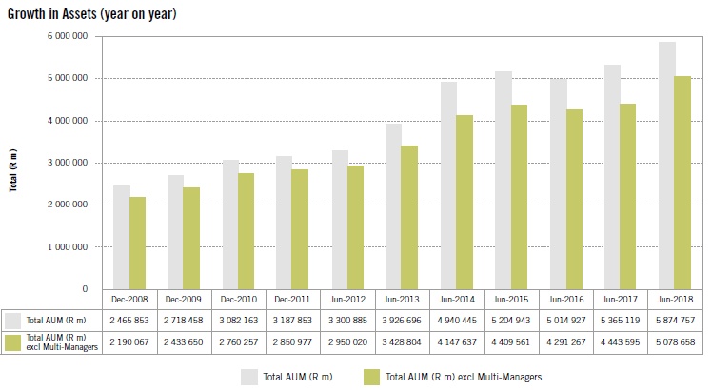
Total Value of Assets Managed
31 December 2008 to 30 June 2018

Slide 8
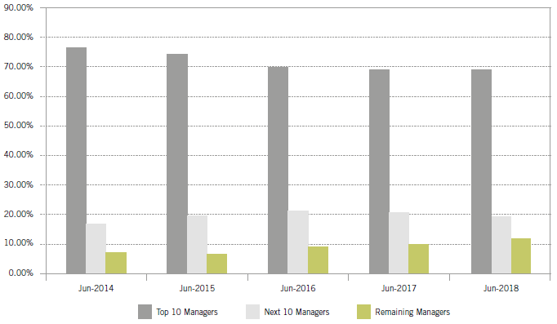
Asset Distribution by Manager Size
The top 10 managers represent nearly 70% of AUM
The next 10 managers represent nearly 20% of AUM
The remaining managers represent just over 10% of AUM

Slide 9
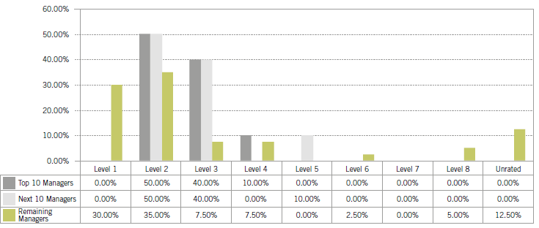
BEE ratings according to Manager Distribution
12 of the 60 investment managers are rated Level 1
Half of the top 20 are rated Level 2
No Level 1 contributors in the top 20 managers
5 managers are unrated

Slide 10
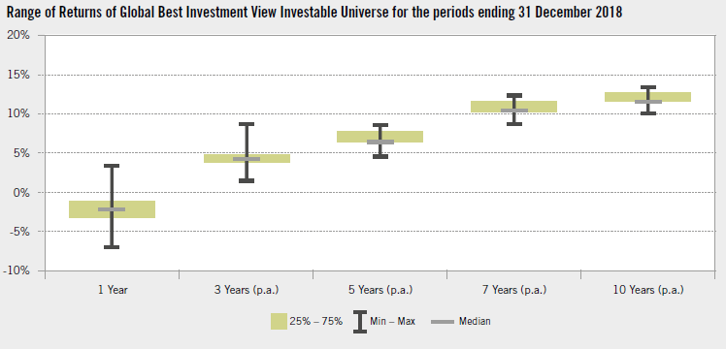
Global Balanced Manager WatchTM Survey – Best Investment View
Only 3 out of 27 managers recorded positive returns for 2018

Slide 11
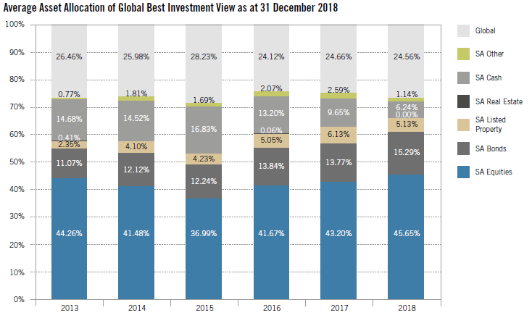
Global Balanced Manager WatchTM Survey – Best Investment View
Most managers close to maximum 30% offshore
Only nine managers were at 26% or less
Kagiso was lowest at 15.5%, followed by Cadiz at 15.6% and Ashburton at 22.5%

Slide 12
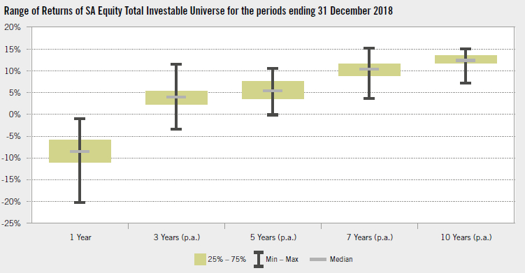
SA Equity Manager Watch™ Survey
2018 was a tough year for SA equity managers
The best-performing manager over one year period with a return of -1.06% was Rezco

Slide 13
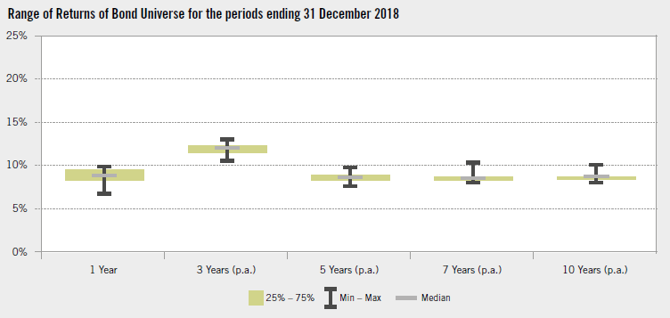
SA Bond Manager Watch™ Survey
It was a much better year for bonds and bond managers
In line with longer term returns

Slide 14
Shari’ah Manager WatchTM Survey
With additional rules and limitations placed on Shari’ah compliant funds, there is a misperception that Shari’ah investing results in lower returns compared to conventional investing
In fact, over the past few years SA Shari’ah Equity funds have done particularly well compared to their conventional SA equity counterparts
Fund of Hedge Funds

Slide 15
Comparing the performance of some surveys
Manager Watch™ Surveys | Average 1-year return: December 2018 | Average 3-year return: December 2018
BEE Bond | 8.64% | 11.80%
SA Bonds | 8.60% | 12.01%
SA Money Market | 8.45% | 8.60%
BEE Money Market | 8.42% | 8.54%
Inflation | 5.18% | 5.47%
SA Fund of Hedge Funds | 3.42% | 4.37%
Global Manager Watch™ – Best Investment View | -1.91% | 4.46%
SA Manager Watch™– Best Investment View | -5.55% | 4.88%
SA Equity | -8.73% | 3.82%
BEE Equity | -9.22% | 4.34%

Slide 16
Fund of Hedge Funds Manager Watch™ Survey
Hedge funds outperformed equities and property with lower risk when markets were under pressure
Of the Funds included in the survey, 12 out of 14 funds achieved positive one-year returns
The average three-year standard deviation was 3.9% vs 6.8% for bonds

Slide 17
Maximum, minimum and average fees charged
Highest
Global Absolute mandates remain the most expensive ranging between 77 and 109bps, average 85bps
Domestic Money Market mandates are the cheapest ranging between 16 and 24 bps
Lowest

Slide 18
Annual Retirement Fund Survey
“Alexander Forbes will introduce the Africa survey in the third quarter of 2019 as its performance surveys continue to evolve and create platforms which cater for diversity and inclusion within the investment industry”

Slide 19
Annual Retirement Fund Survey
“Over the last three to five years, typical retirement fund strategies have struggled to produce returns above inflation given market conditions.
However, over 10 years, the average retirement fund strategy has achieved returns above inflation of 6% per annum.
This reminds us of the importance of sticking to good principles in structuring retirement fund strategies ”

Slide 20
FAIS Compliance statement – Alexander Forbes Investments Limited
Alexander Forbes Investments Limited (registration number 1997/000595/06) is an authorised Financial Services Provider (FSP711), in terms of Section 8 of the Financial Advisory and Intermediary Services Act 37 of 2002 (FAIS Act), as amended. Alexander Forbes Investments Limited is a registered long-term insurer (Long-term insurance licence number: 00018/001), and pension fund administrator (Pension fund administrator number: 24/217)
Alexander Forbes Investments Limited is licensed in terms of Category I (advice & non-discretionary intermediary services), Category II (discretionary intermediary services) and Category IIA (Hedge Fund FSP)
Alexander Forbes Investments Limited is authorised to provide financial services in respect of the following financial products: Long-term insurance subcategory B1; Long-term insurance subcategory B2; Long-term insurance subcategory B1-A; Long-term insurance subcategory B2-A; Long-term insurance subcategory C; Retail Pension Benefits; Pension Fund Benefits; Shares; Money market instruments; Debentures and securitised debt; Warrants, certificates and other instruments; Bonds; Derivative instruments; Participatory Interests in a collective investment scheme; Long-term Deposits; Short-term Deposits; General Category IIA experience
The information contained in this presentation in respect of any product is factual information, and does not constitute financial advice, as contemplated in section 1 of the FAIS Act. No guarantee is provided
Opinions and views expressed on various issues, such as, but not limited to, economic, legal or regulatory overviews during this presentation should not be construed as advice, nor should it be construed as express or implied recommendations, guidance, or proposals that any particular transaction, in respect of a product, is appropriate for your particular investment objectives, financial situation, or particular needs
  Therefore, the opinions expressed during this presentation should not be relied on for the purposes of making any financial, investment or other decision, and you should consult with your own independent expert advisor, such as an economist, legal or tax advisor or financial services provider, before entering into any transaction
Certain divisions within Alexander Forbes Investments may have been appointed by the client to furnish advice to the client
  A portion of this presentation may deal with the advice furnished by the relevant division within Alexander Forbes Investments
  The individual giving this presentation is not necessarily part of that division
  Any advice and/or recommendation is not advice and/or recommendation of the presenter, but of the division within Alexander Forbes Investments, authorised to provide the advice
  Reliance should not be placed on the information in this presentation, but rather on the official report containing the advice

Slide 21
FAIS Compliance statement – Alexander Forbes Investments Limited (continued)
Alexander Forbes Investments holds professional indemnity and fidelity insurance cover, in excess of the minimum requirements stipulated in the General Code of Conduct and Board Notices to the FAIS Act
Any information disclosed to the authorised representatives in their professional capacity will be treated as confidential, and will not be disclosed to third parties without written consent, unless the disclosure of such information is required in the public interest or under a particular law
The Conflicts of Interest Management Policy is available on the Alexander Forbes Investments website (www.alexanderforbesinvestments.co.za). Portfolios managed by Alexander Forbes Investments may include investments of associate companies. Alexander Forbes Investments may provide investment services to clients who receive other investment services from associated companies. Alexander Forbes Investments Holdings Limited is a wholly-owned subsidiary of Alexander Forbes Limited. The company structure is available upon request.
Alexander Forbes Investments aims to treat all customers fairly. The Complaints Policy is available on the Alexander Forbes Investments website (www.alexanderforbesinvestments.co.za. Please address all complaints to our Contact Centre at 0860 333 316 or afinvestcontactcentre@aforbes.com.
Alexander Forbes Investments shall not be liable for any damage or loss suffered, resulting from any action taken by any person based on this presentation, information provided in it or any discussions relating to it
Please be advised that there may be representatives acting under supervision

